Slide 1
Employee Data Analysis using Excel
STUDENT NAME: Vikas R
REGISTER NO: 312207134, Unm130122B277
DEPARTMENT: BCOM General
COLLEGE: A.M. Jain college

Slide 2
PROJECT TITLE
Employee Performance Analysis using Excel

Slide 3


AGENDA
Problem Statement
Project Overview
End Users
Our Solution and Proposition
Dataset Description
Modelling Approach
Results and Discussion
Conclusion
3/21/2024 Annual Review

Slide 4

PROBLEM STATEMENT
Analyze employee data to identify trends and insights related to workforce demographics, performance, and retention. The goal is to provide actionable recommendations that support strategic decision-making for improving employee engagement, productivity, and overall organizational effectiveness.

Slide 5

PROJECT OVERVIEW
.
Employee data analysis involves examining workforce information, including demographics, performance, and retention metrics, to uncover patterns and trends. This project aims to provide insights that can drive informed decision-making, improve employee engagement, optimize productivity, and support organizational growth.

Slide 6



WHO ARE THE END USERS?
The end users of an employee performance analysis using Excel typically include:
Human Resources (HR) Department
Department Managers and Team Leaders.
Senior Management and Executives.
Performance Review Committees.

Slide 7

OUR SOLUTION AND ITS VALUE PROPOSITION
The project will involve the creation of an Excel-Based Performance analysis tool that will:
Integrate Data
Analyze Performance
Visualize Data
Facilitate Reporting.

Slide 8
Dataset Description
EMPLOYEE DATA SET – KAGGLE
26 FEATURE
FEATURE- 9 FEATURE
EMPLOYEE ID- CATEGORICAL DATA
GENDER- MALE,FEMALE
PERFORMANCE LEVEL- ORDINAL DATA
BUSINESS UNIT- REFERENCE DATA SET
NAME- NOMINAL DATA
RATING- NUMERICAL VALUE

Slide 9

THE "WOW" IN OUR SOLUTION
Our solution stands out by leveraging advanced data analytics to deliver precise, actionable insights that go beyond surface-level metrics. We offer predictive models for employee turnover, personalized recommendations for engagement strategies, and a dynamic dashboard for real-time monitoring, enabling proactive decision-making that directly enhances employee satisfaction and productivity.
New Formula used : : IFS
EG:IFS(Z8≥5,"VERYHIGH",Z8≥4,"HIGH",Z8≥3,"MEDIUM",TRUE,"LOW").
3/21/2024 Annual Review
9

Slide 10
MODELLING
Tools and Techniques in Excel :
Pivot Tables: For summarizing and analyzing data across different dimensions such as department, job title, or performance ratings.
Charts and Graphs: To visualize trends, distributions, and correlations within the dataset.
Formulas: Use Excel functions like VLOOKUP, SUMIFS, and AVERAGEIFS to perform calculations and derive additional insights from the data.
10

Slide 11
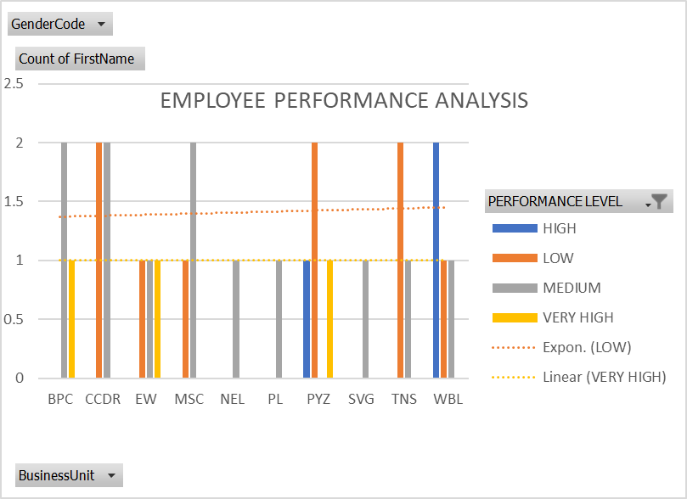
RESULTS
11

Slide 12

conclusion
In conclusion, our employee data analysis provides valuable insights that can guide strategic decisions, improve workforce engagement, and optimize productivity. By leveraging data-driven solutions, we empower the organization to make informed, proactive choices that foster a more engaged and efficient workforce.

